Slide 1
UTIVA BIG DATA ANALYTICS WITH PYTHON
Capstone Project

Slide 2
Capstone Project
Name: Abiye Danagogo
Email: abiyedanagogo@gmail.com
Country: Nigeria
Project Title: Employee Attrition Control

Slide 3
Problem Statement and Background
A company X is trying to control attrition. There are two sets of data: “Existing employees” and “Employees who have left”. The following attributes are available for every employee:
Satisfaction Level
Last evaluation
Number of projects
Average monthly hours
Time spent at the company
Whether they have had a work accident
Whether they have had a promotion in the last 5 years
Departments
Salary

Slide 4
Problem Statement and Background
Objective: Use your analytics skills to help the company by answering the following questions.
What type of employees are leaving?
Which employees are prone to leave next?
What are your recommendations?

Slide 5
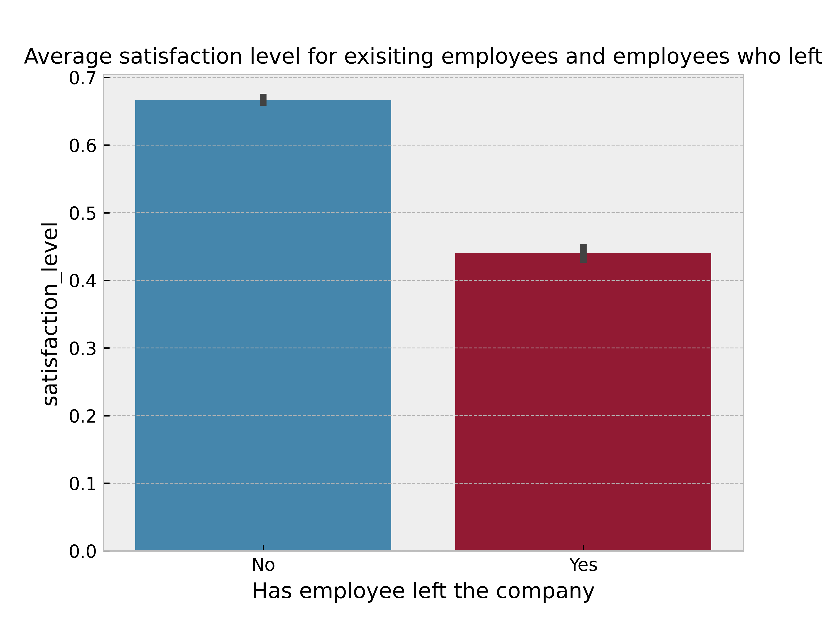
Data Visualisation and exploration
CHART 1
Looking at the plot above you can see that for employees that did not leave they have an average satisfaction level of about 0.67 while the employees that left the company have an average satisfaction level of 0.44. This shows that the employees that left have on average a lower satisfaction level than existing employees.
This means that satisfaction level is most likely a factor of employee attrition.

Slide 6
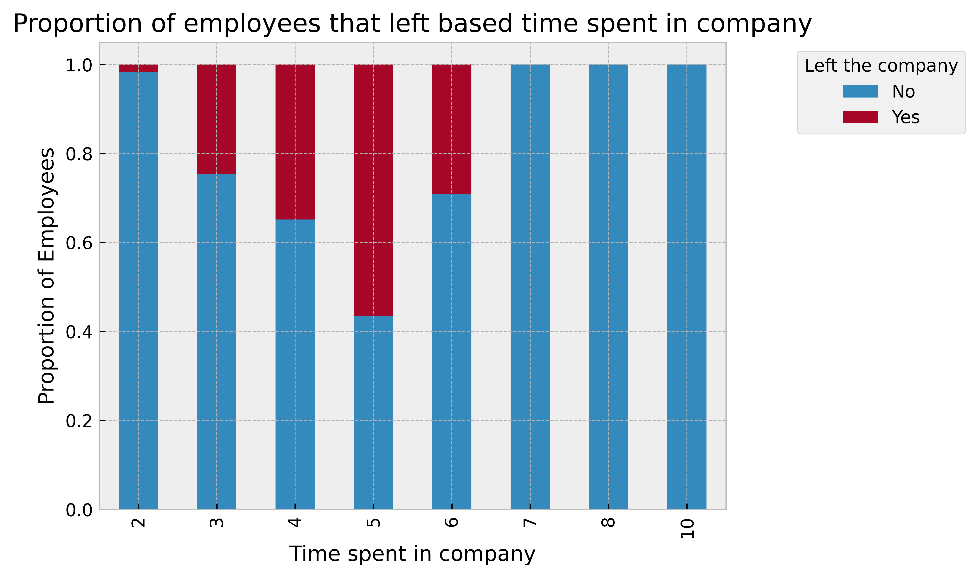
Data Visualisation and exploration
CHART 2
The above graph shows the proportion of employees that left based on the time spent in the company. We can see that people that spend 2 years in the company hardly leave. Then from people that spend 3 years until 5 years there is an increase in the proportion of leave. Then for people that spent 6 years there is a decrease from people that spent 5 years although still a significant proportion of people leave. This indicates that the type of employees that usually leave are employees that have spent 3, 4, 5 and 6 years in the company.
We can also see that no employee that has spent above 6 years left the company. We can conclude that employees that have spent more than 6 years in the company are less likely to leave.

Slide 7
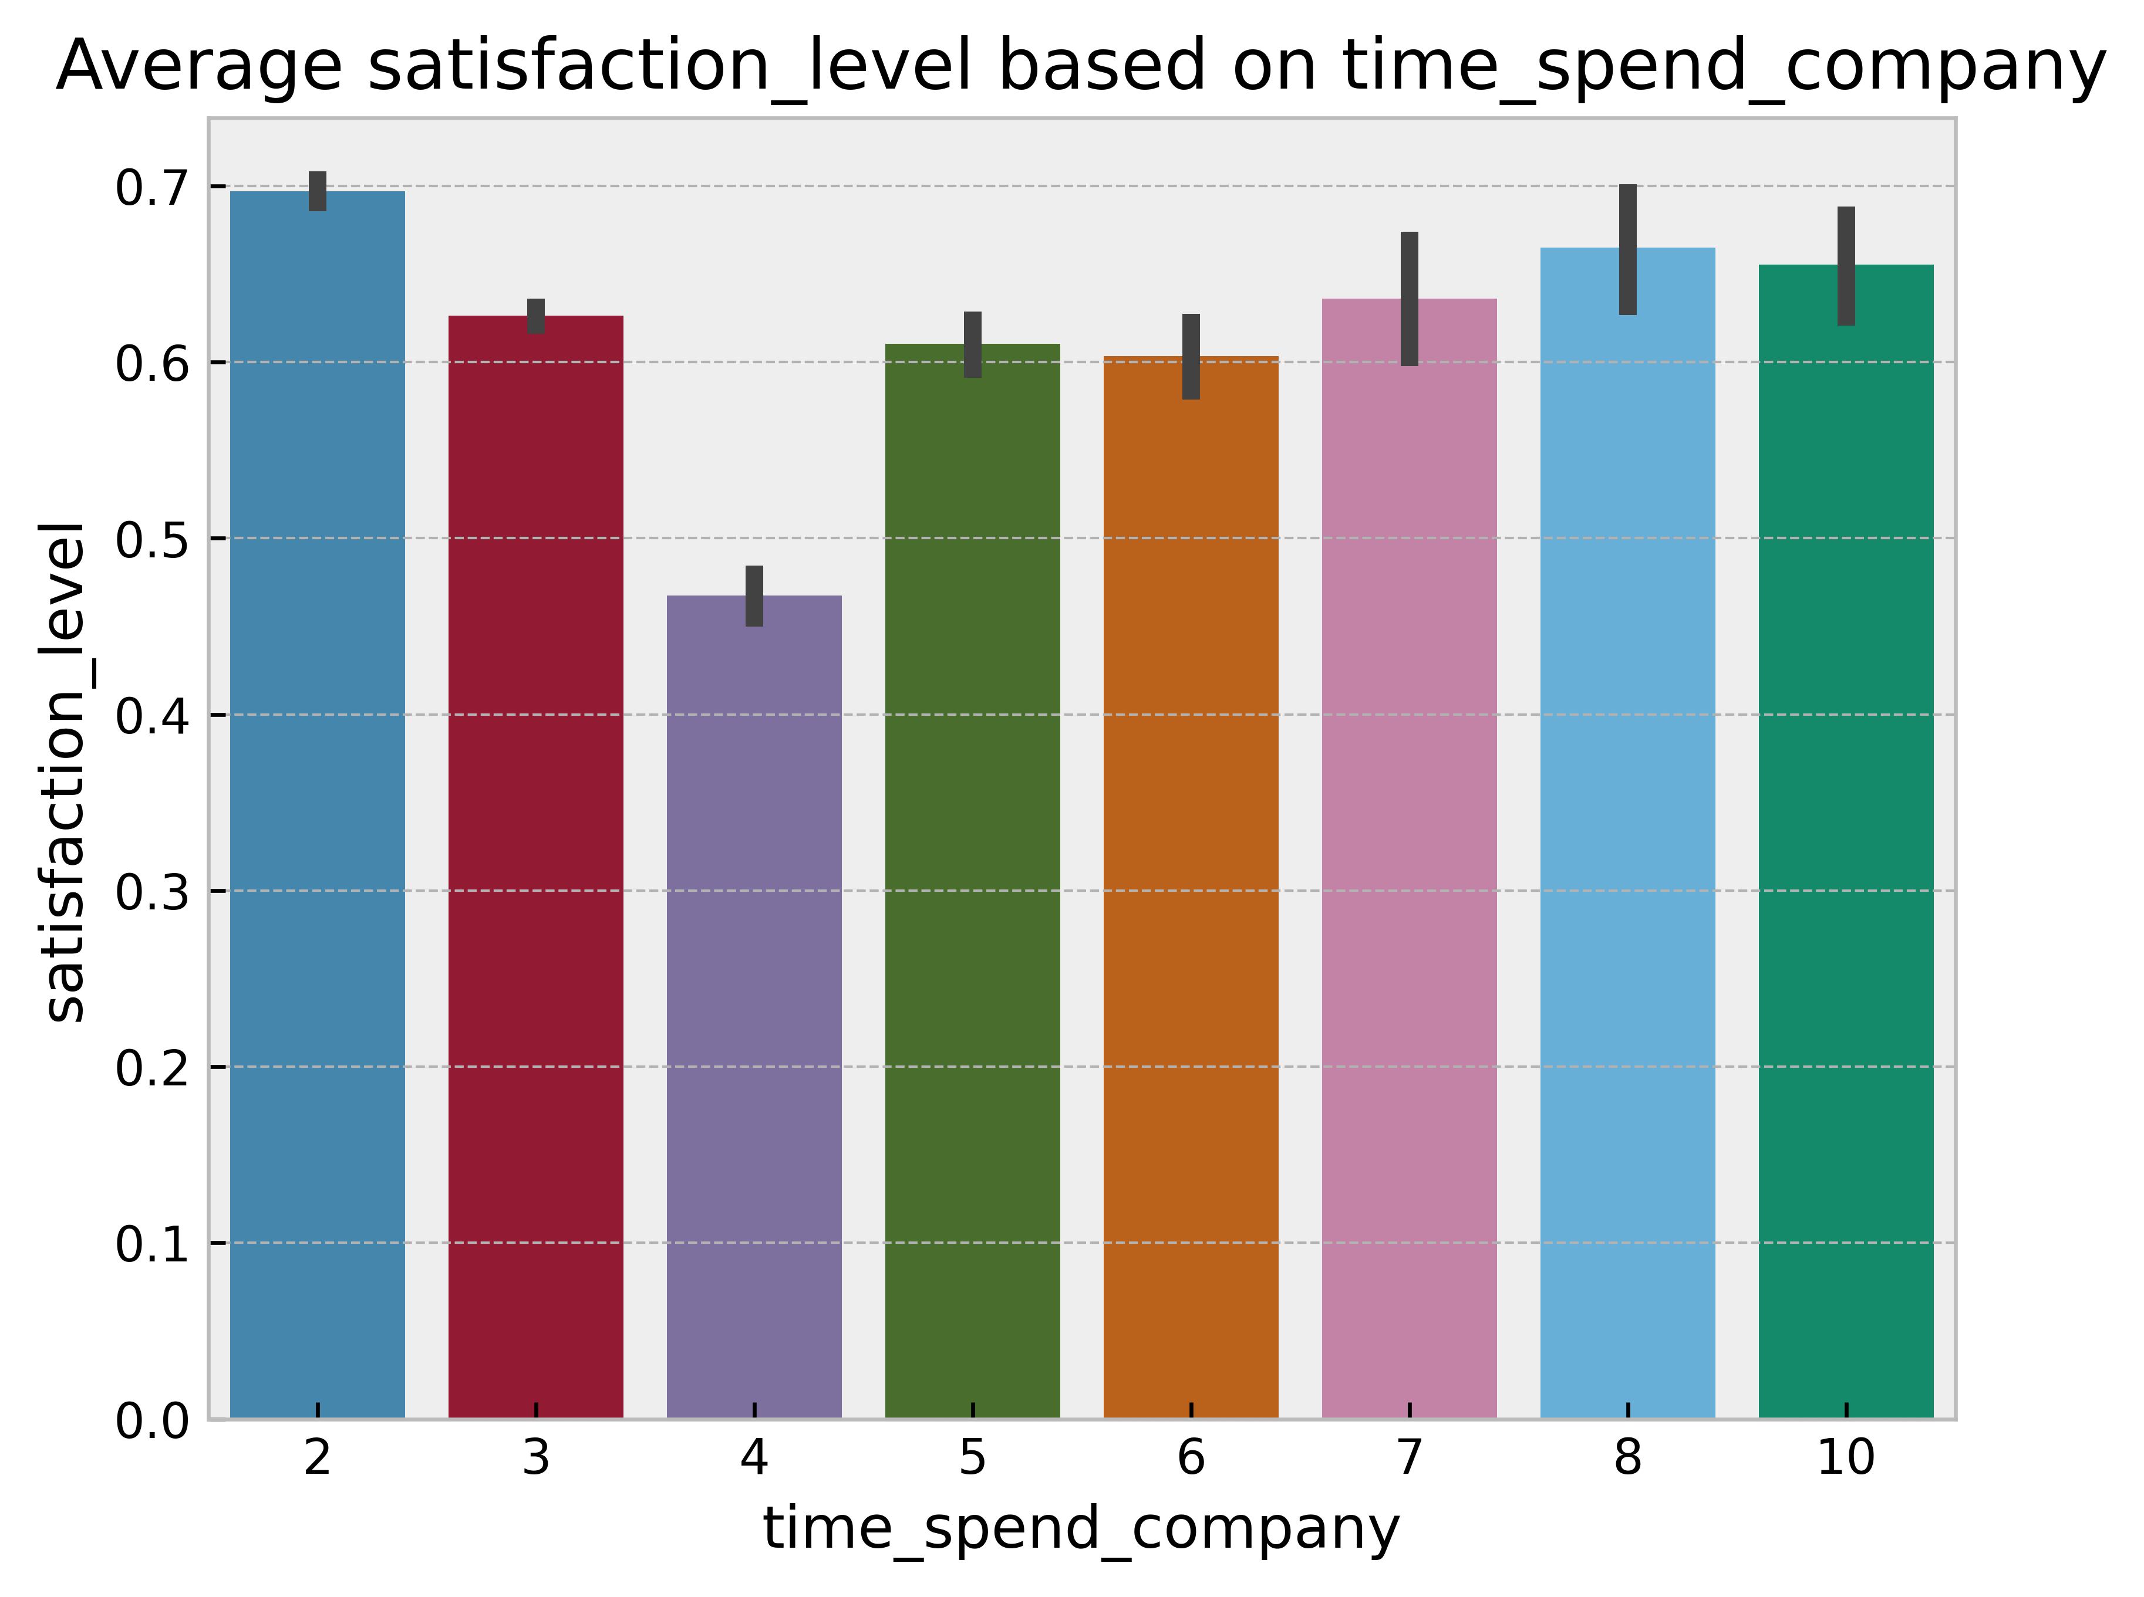
Data Visualisation and exploration
CHART 3
The above bar chart shows the average satisfaction level of all employees based on time spent in the company. We can see that employees who have spent 4 years have the lowest average satisfaction levels of everyone in the company. Also employees that have spent 3,5 and 6 also have lower satisfaction levels than other employees. This makes sense considering that employees in year 3,4,5 and 6 have the highest proportion of people that leave.

Slide 8
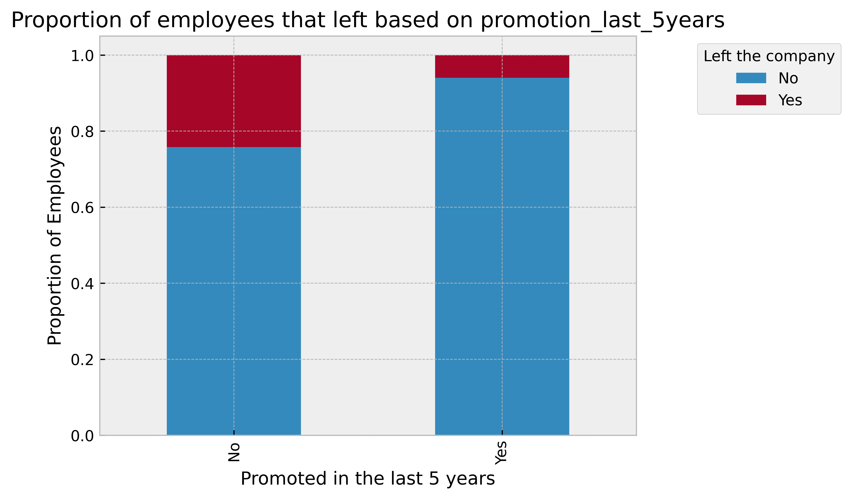
Data Visualisation and exploration
CHART 4
The bar chart shows the employees that were promoted in the last 5 years and the ones that were not. It then shows the proportion of them that left the company or stayed. For employees that were not promoted you can see that about 24.2% of them left, while for employees who were promoted you can see that just about 6% left. This shows that promotion is a factor for employee attrition as a higher percentage of people left if they were not promoted within the last 5 years.

Slide 9
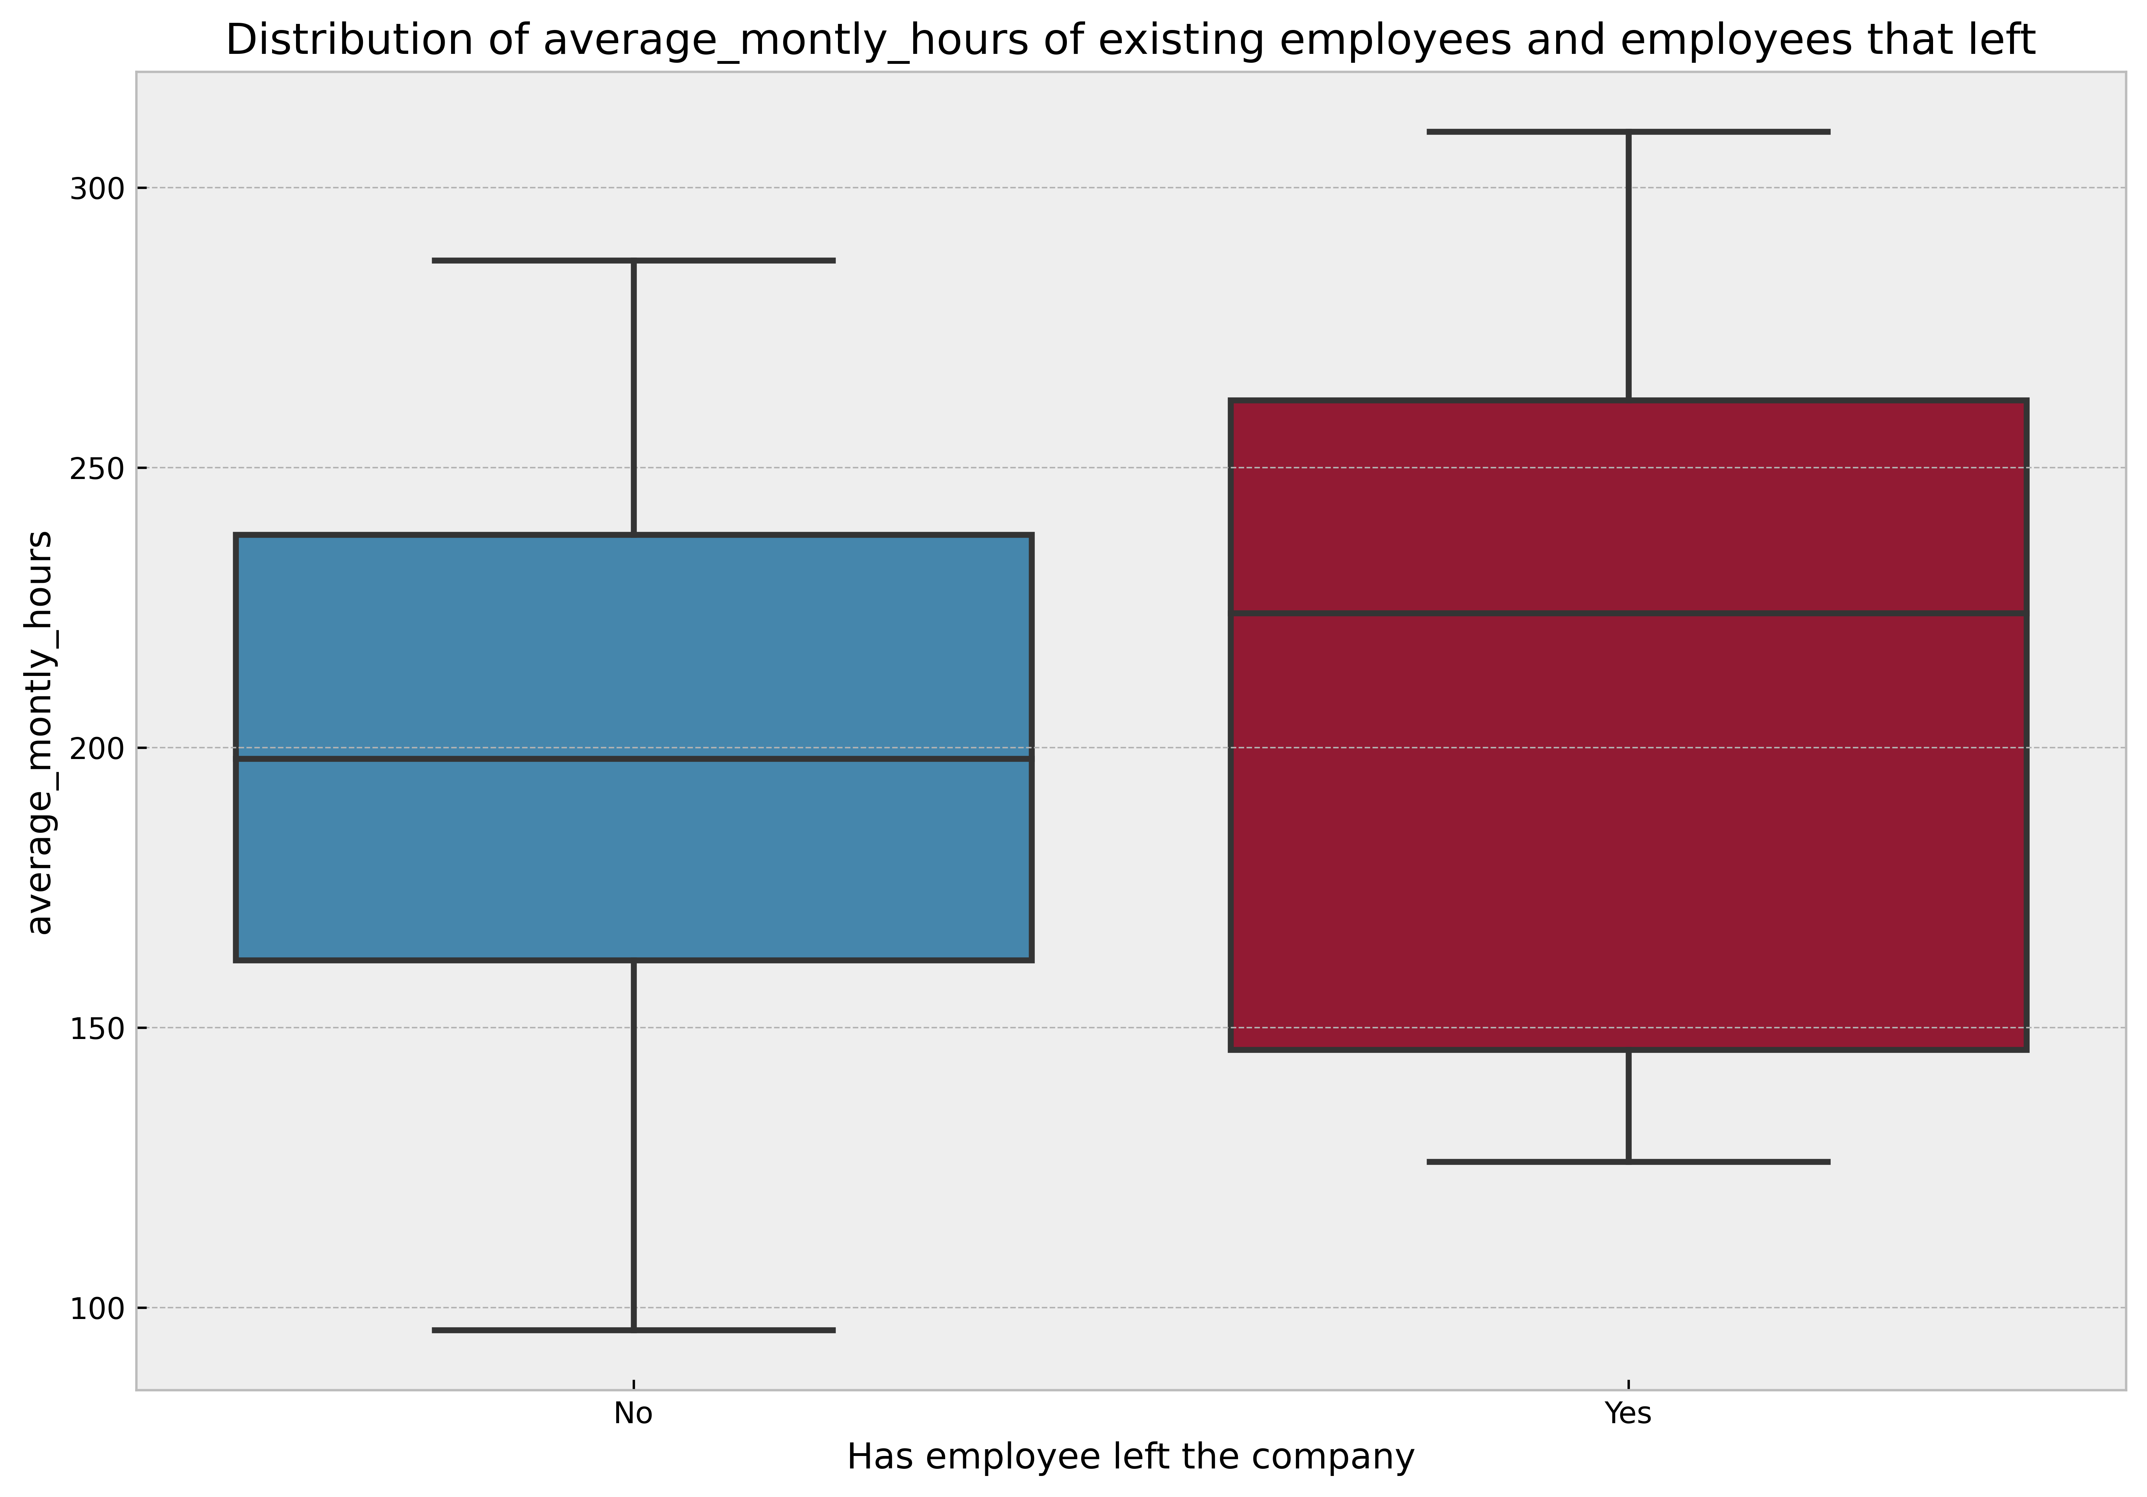
Data Visualisation and exploration
CHART 5
The box plot above shows the distribution of the average monthly hours of existing employees and employees that left. We can see that the average for all employees that left is about 207 hours, while for existing employees is about 199 hours.
From this plot we can conclude that the employees who left worked more hours on average than existing employees.

Slide 10
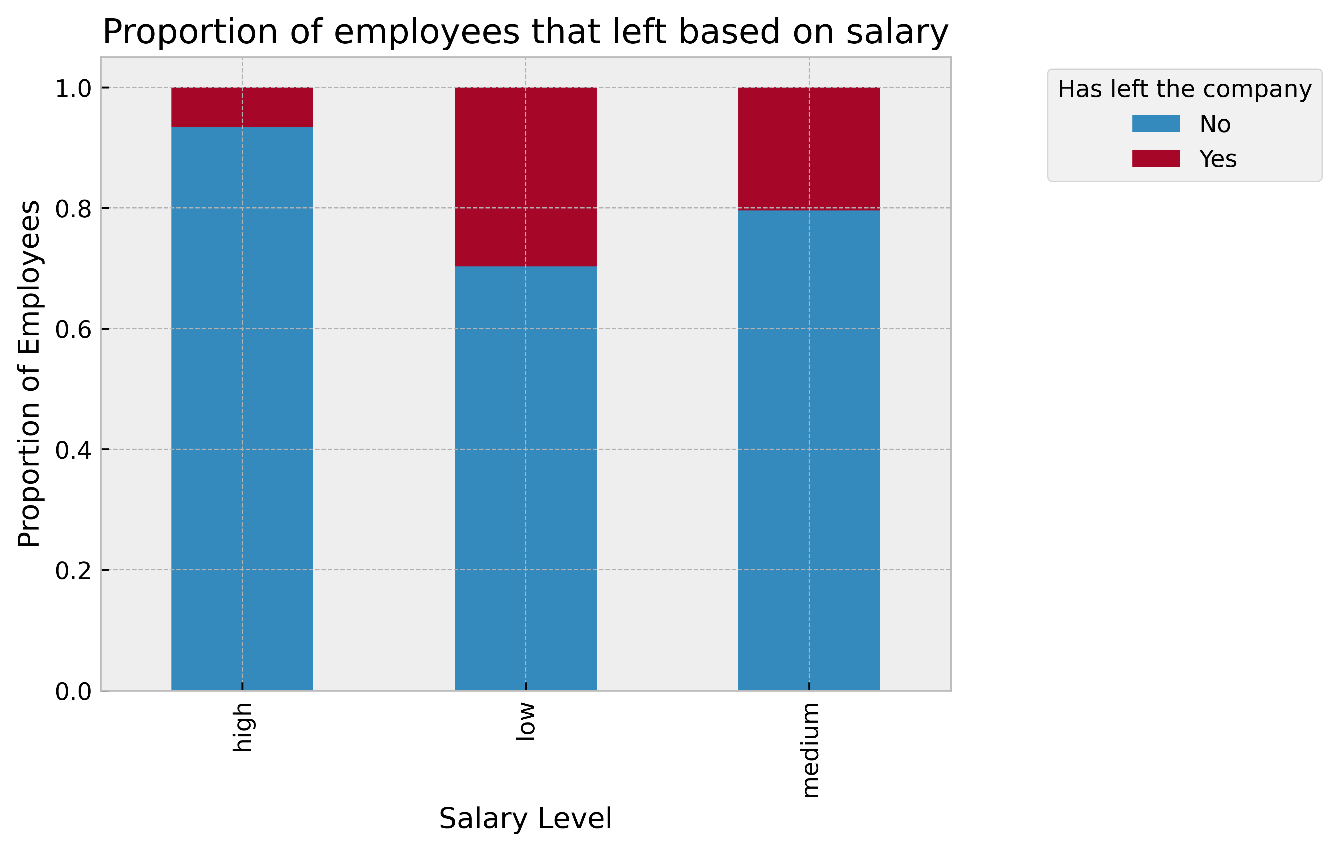
Data Visualisation and exploration
CHART 6
From this graph you can see that employees with low salaries have the highest proportion of people that left the company followed by employees with medium salaries then employees with high salaries.
We can conclude that the salary level is a factor of employee attrition. The lesser the salary the higher chance of an employee leaving the company.

Slide 11
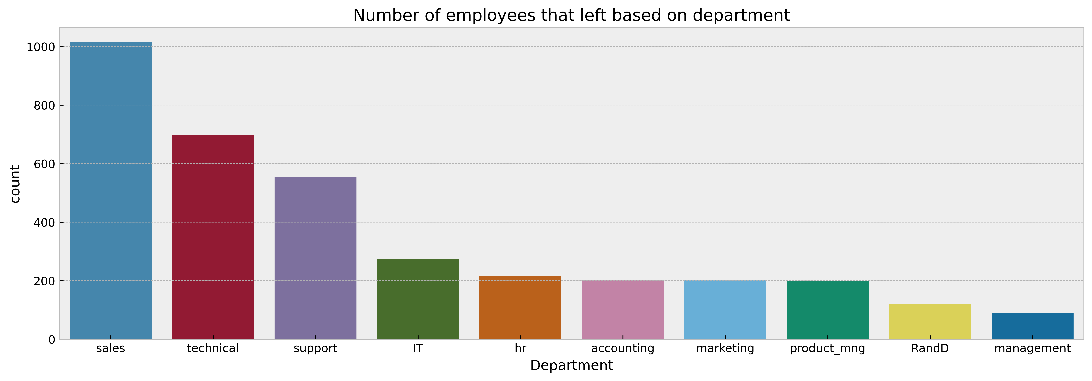
Data Visualisation and exploration
CHART 7
This chart shows the number of employees that left based on their department. We can see that employees from sales, technical and support had the highest number of employees that left. From this we can conclude that the department is also one of the factors of employee attrition.

Slide 12
PREDICTIONS
From the insights gathered from the charts we can make conclusions about which kind of employees are prone to leave next:
Employees having a satisfaction level below the average of 44%
Employees that a have spent a duration of 3,4,5 and 6 years.
Employees that have not been promoted within the last 5 years.
Employees with higher average monthly hours are prone to leave.
Employees with low salary

Slide 13
Model and validation
The Random Forest classifier was used to predict employee attrition. The model should be able to predict which employees are prone to leave based on the different features of the dataset.
The model has an accuracy score of 99% as seen below from the classification report. This means the model is very accurate.
precision recall f1-score support
0 0.99 1.00 0.99 3442
1 0.99 0.97 0.98 1058
accuracy 0.99 4500
macro avg 0.99 0.98 0.99 4500
weighted avg 0.99 0.99 0.99 4500

Slide 14
RECOMMENDATIONS
In the dataset it is seen that employees with lower satisfaction levels tend to leave. The company should identify and compensate employees in diverse ways such as with a promotion or an increase in salary so as to increase their satisfaction level and loyalty to the company.
These benefits should especially be targeted at employees that have spent 3,4,5 and 6 years in the company as employees in this range tend to have a higher proportion of themselves leaving the company and also the lowest satisfaction levels.
The company could look at reducing the hours of some workers. This is because on average the employees that left had higher average monthly hours.

